Slide 1
Citi Bikes Usage
Laura Rice

Slide 2
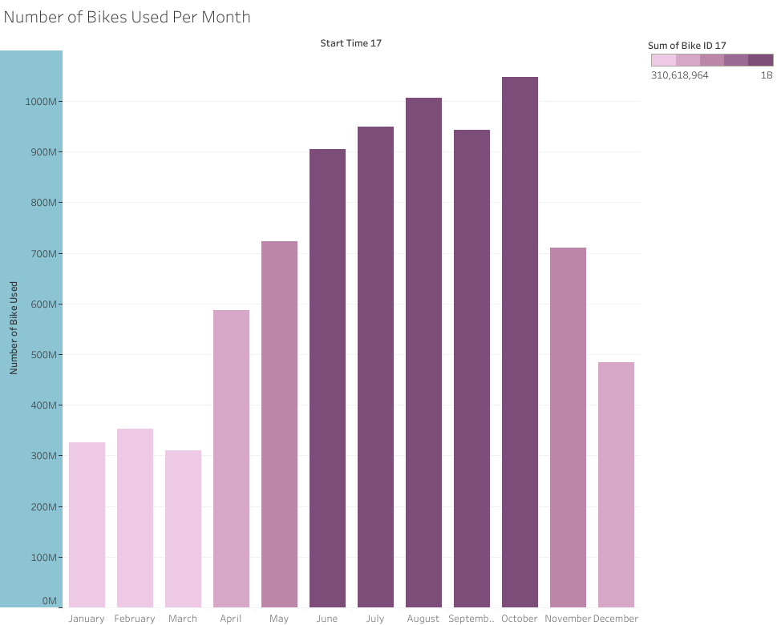
Bike Usage Per Month
Taking a count of the number of bikes rented within each month:
Counts are naturally lower in winter months
Things pick up in April and then peak in the summer months
High counts continue through October and then strongly decline

Slide 3
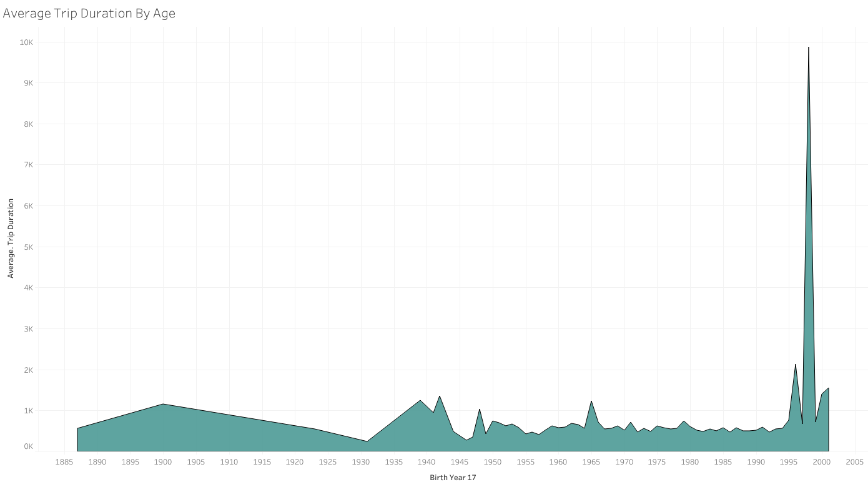
Duration of Trips Based on Age
Naturally the younger crowd is more willing to take longer trips
The most common ages are between 20 and 25
Peaking around the age of 22 and 23

Slide 4
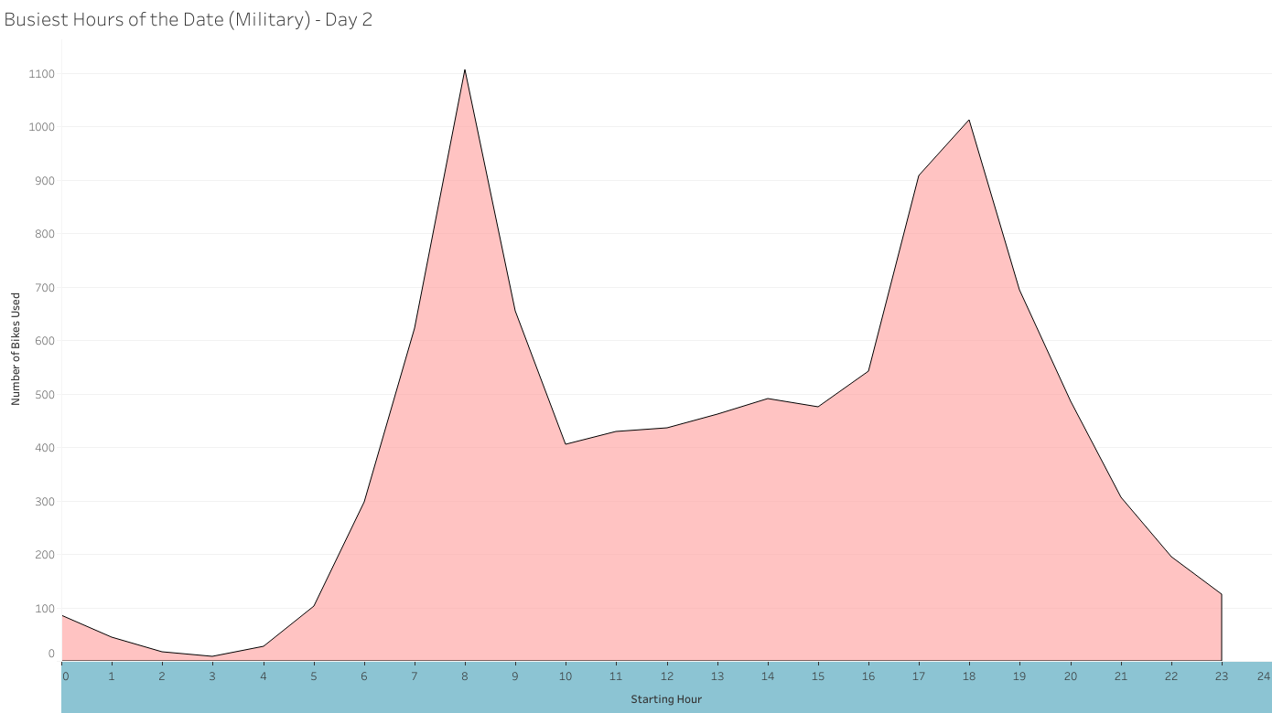
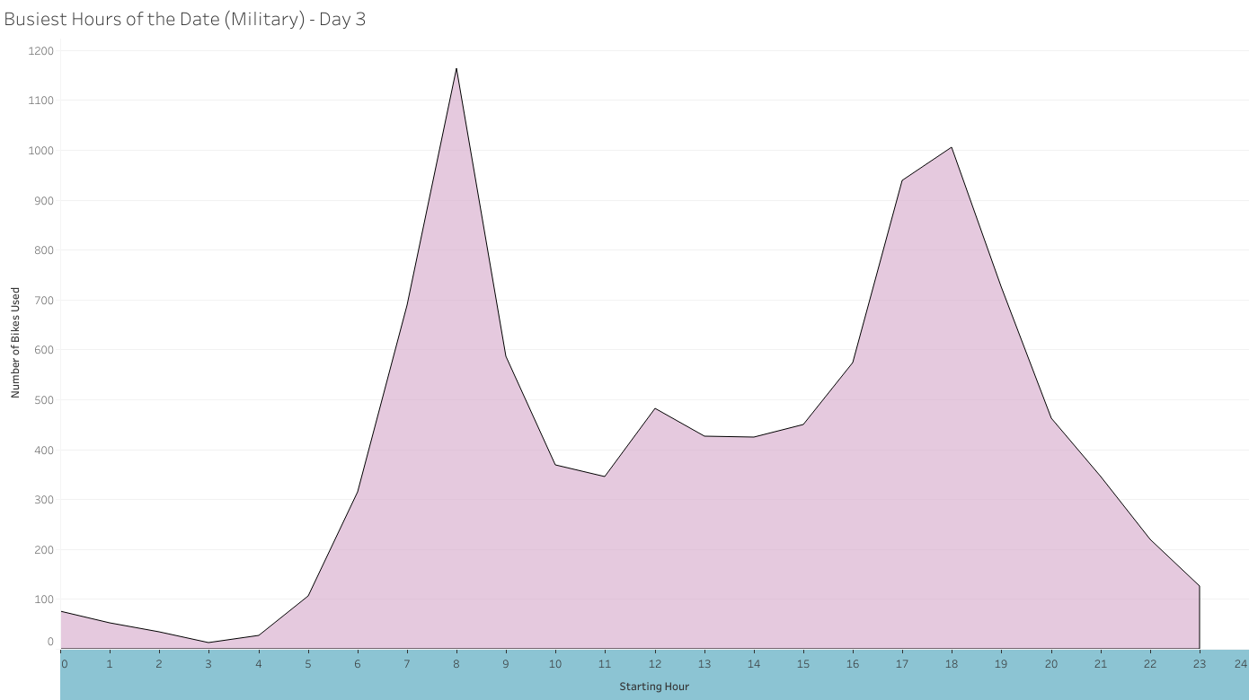
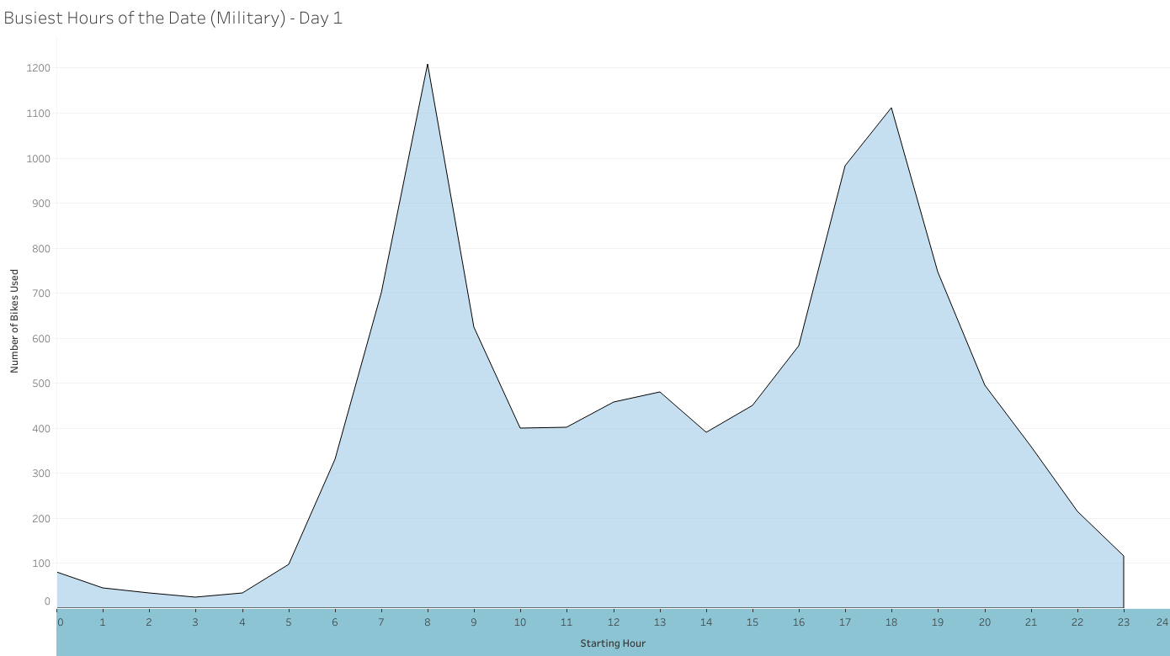
Peak Hours for Bike Usage
Looking at the number of bikes used by the hour and comparing multiple days:
Peak hours are at 8:00am and 6:00pm
Staring to incline around 5:00am when people go to work and school
Having a average amount in between
And inkling again around 4:00pm when people head home

Slide 5
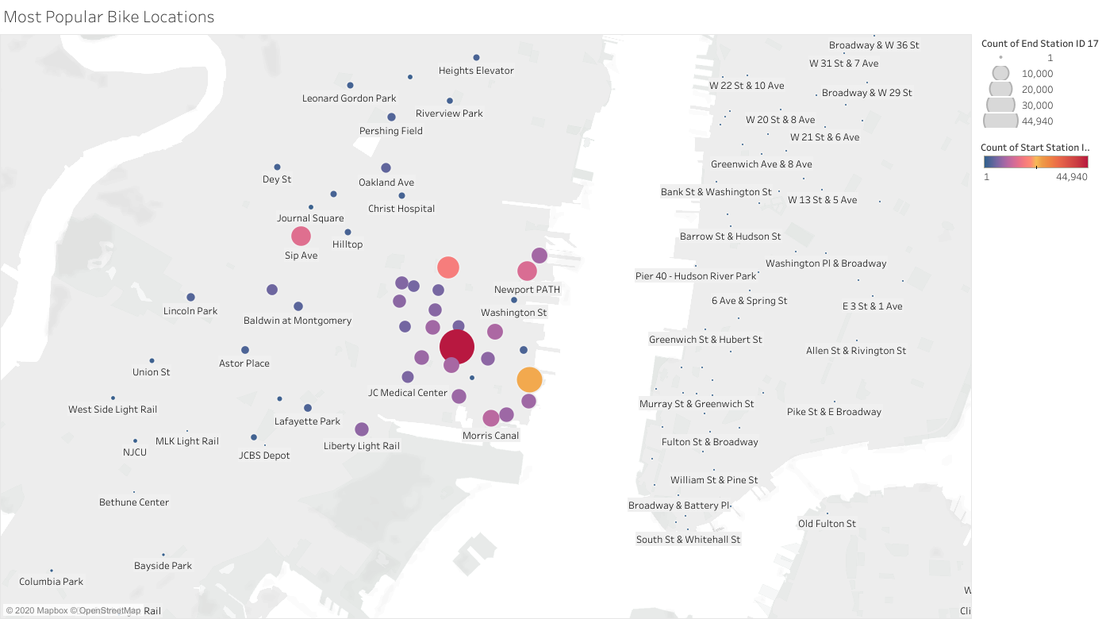
Popular Locations
Looking at the map, the location of each rental area are plotted.
The more the red the icon, the more popular as a pick up location
The larger the icon, the more popular as a drop off location
Most popular locations:
Grove Street Path
Hamilton Park
Sip Avenue
They also congregate in Newport

